Slide 1
Introduction to Particle-in-cell(PIC)

Slide 2
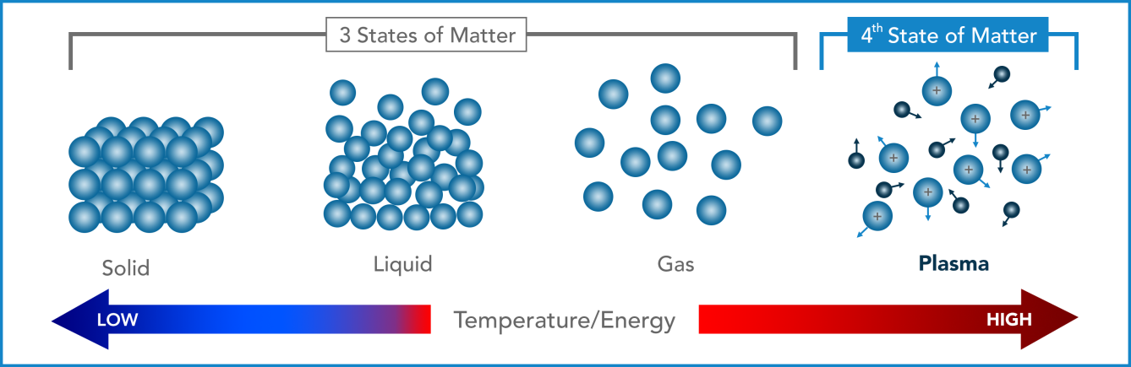
what is plasma?
Plasma is called the fourth state of matter.
Plasma is a collectoin of positive and negative charged species and exhibits neutral as a whole. The electro-magnetic interaction dominates a plasma.
Plasma contains:
Electrons
Positive/Negative ions
Radicals/Excited
Stable species

Slide 3
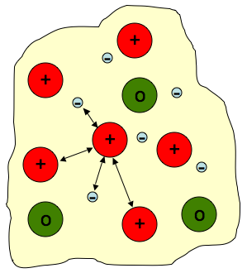
plasma state
Plasma consists of:
Electrons: driven by E/B-field, light mass with high speed/energy
Ions: driven by E/B-field, heavy mass with low speed/energy
Neutral atoms/molecules: not affected by field, equilibrium to room temperature.
E-field: induced by charge imbalance
Photons: emitted by excited atoms/molecules, can be absorbed by atoms/molecules
Plasma consists of PARTICLEs and FIELDs.

Slide 4
Basic concepts
Debye Length
Mean Free Path
Plasma Oscillation Frequency
Plasma Criteria

Slide 5
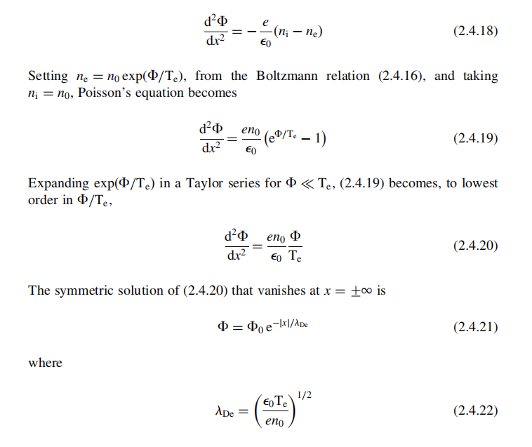
Debye length
Poisson's Equation
Boltzmann Relation
The characteristic length scale in a plasma is the electron Debye length λ_{De}.
The Debye length is the distance scale over which significant charge densities can spontaneously exist. In anothre word, plasma can be viewed as neutral beyond Debye length.
T_{e} ↑ → λ_{De} ↑
n_{e} ↑ → λ_{De} ↓

Slide 6
Physical meaning of Debye length
It is the “screening” distance, or the distance over which the usual Coulomb 1/r field is killed off exponentially by the polarization of the plasma. This is the most important length in plasma physics.
If you have a gas with equal numbers of charged particles in which this length is larger than the size of the gas, you don’t have to do plasma physics. But if the Debye length is smaller than the size of the gas, then you have to consider the fact that electric fields applied to such plasmas don’t penetrate into them any deeper than a few Debye lengths.
U→0
λ_{D}

Slide 7
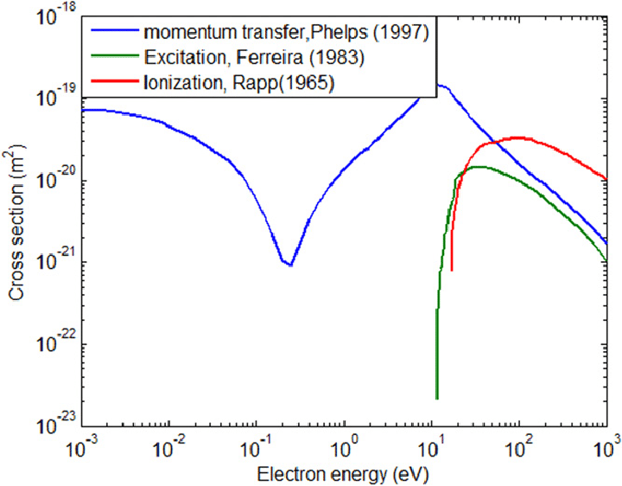
Collision cross section
The cross section (unit: m²) is used to descrie the possibility of particle collisions.
In hard ball model, assuming the radius of neutral particle is r, n-n collision cross section is 4πr², while e-n cross section is πr².
In real case, cross section is energy-dependent.
Hard Ball Model:
Cross section σ=π(r₁+r₂)²
e + Ar
cross section

Slide 8
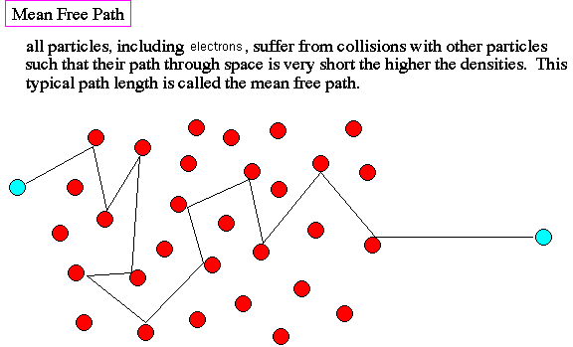
mean free path
Collisionless → Kinetic effect dominates.
Collisional → Diffusion dominates. Fuild Model!
mean free path
collision
frequency

Slide 9
Plasma oscillation frequency
Ion
e
Electrons oscillate with respect to plasma due to charge separation.
A
Plasma
dx
Plasma
Electron oscillation frequency and ion oscillation frequency

Slide 10
plasma criteria
Plasma is quasi-neutral as a whole
There is sufficient charge density within a Debye sphere, so electric field can be screened.
Electron osscillation frequency is larger than collision freuqnecy, so plasma is different from a neutral gas in behaviour.

Slide 11
Modeling of plasmas

Slide 12
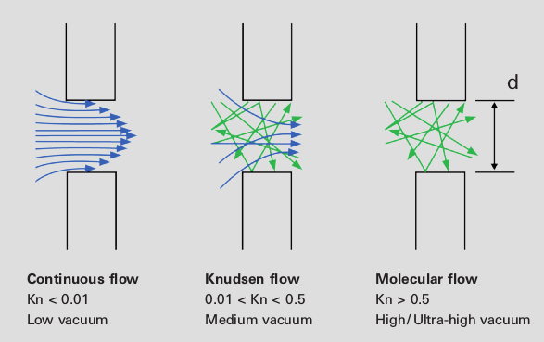
two views of plasma?
Fluid
Particle
Elementary atoms/molecules interact strongly with each other. They move collectively.
You don't need to know individual elements. Instead, you can use macroscopic variables, such as mass center.
Elementary atoms/molecules have weak interaction with each other. They move individually.
There is no collectively movement. You have to know each individual element.

Slide 13
Hierarchy of plasma modeling
Single-Particle Motion
Newton Eq.
Particl In Cell
Plasma
Hybrid Model
distribution function
Boltzmann Eq.
Fluid Model

Slide 14
Description of plasmas
Particle | Fluid
Easy to trach each particle following Newton's Law | Describe the plasma as fluid
Too many particles 10¹⁶ to 10¹⁸ m⁻³, psuedo particle is needed | Not able to catch the kinetic and stochastic phenomena
Charged particles respond to EM field, which is generated by all other charged particles in the system | In general, computationally feasible
Collisions occur frequently and fast so a extremely shrot time scale is required
In general, computationally expensive
The following discussions are based on particle description.

Slide 15
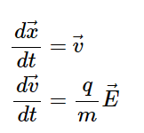
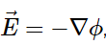
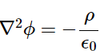
basic equations
Electrostaic Field.
No magnetic field.
Electric field is induced by charge imbalance.
Individual particle advances and is accelerated along the E-field.
E-field is obtained by counting all particles, positive ions - negative ions.
Newton's equation
update ϕ
update n_{e}, n_{i}
Poisson's equation

Slide 16
1d plasma model

Slide 17
pseudo-particle (macro-particle)
Pseudo-particles, each of them representative of a large number of individual particles, are used in PIC.
q(pseudo) = nq and m(pseudo) = nm where n is the “particle weight”, or number of atoms/molecules. q(pseudo)/m(pseudo) = q/m and so, the eqns. of motion are preserved.
n is often large, 10¹⁰ or higher, and the number of pseudo-particles used in the simulation depends on resolution, which should be effectively a sampling of phasespace.
The initial pseudo-particle weight can even vary with position or change dynamically. It means that some pseudo-particles can be larger than others.

Slide 18
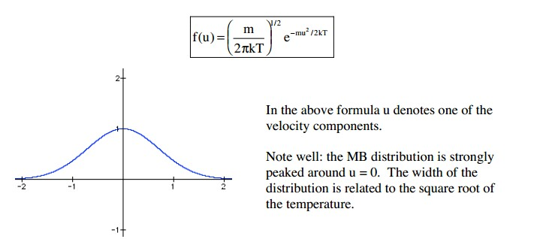
particle initiation
The averge kinetic energy of a particle is
Maxwell velocity distribution
The width of the distribution is called TEMPERATURE.
The higher the temperature, the higher the particle energy.

Slide 19
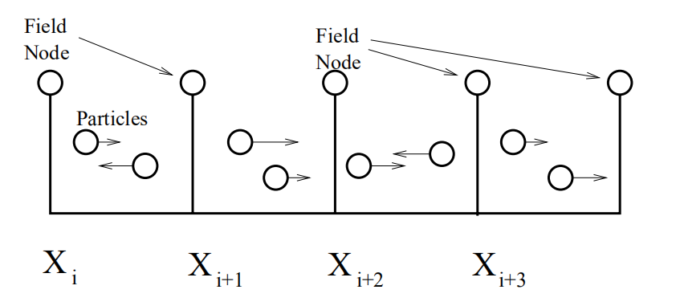
Implement a 1d-electrostatic plasma model
ρ,Φ
The fields are defined on a grid (Field Nodes). x_{i}
Particles move in a continous space. x
Particles interact with the grid though denisty ρ.
Grid interacts with particles through potenital, ρ.
E is defined on cell center/volume.
ρ,Φ
E
Particle densities are assigned to nodes to solve for E-field.

Slide 20
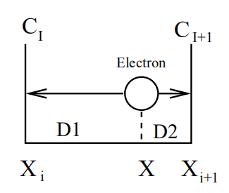
field solver
Locate the cell which a particle belongs to.
Charged particles contribute its charge dnesity to both the boundary nodes.
Weight factor is determined by the relative location of the charged particle.

Slide 21
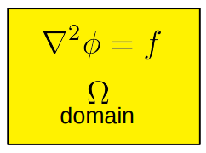
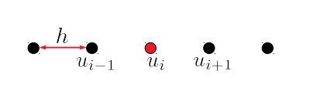
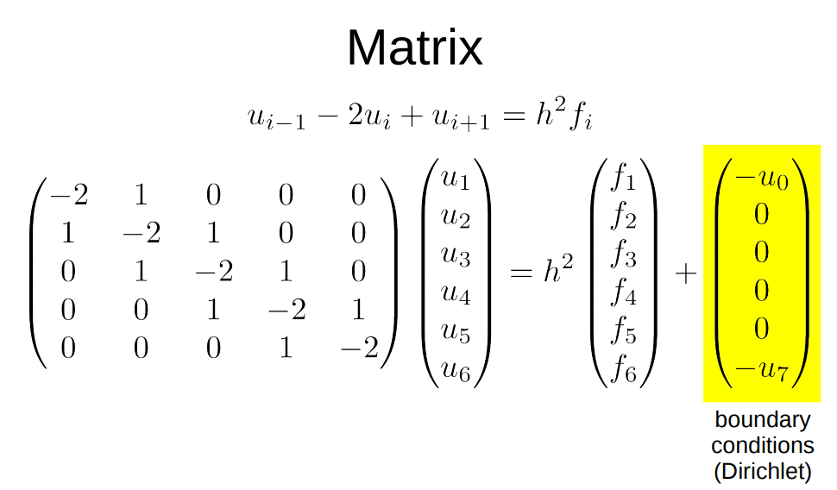
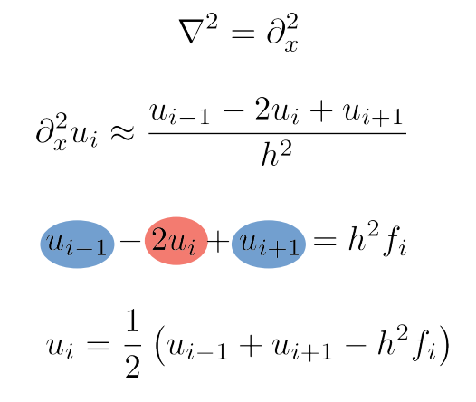
1d possion solver

Slide 22
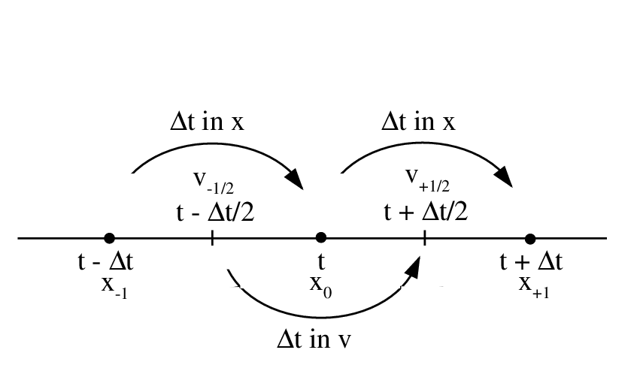
particle pusher - Regular vs leapfrog
Regular Move
Leapfrog Move

Slide 23
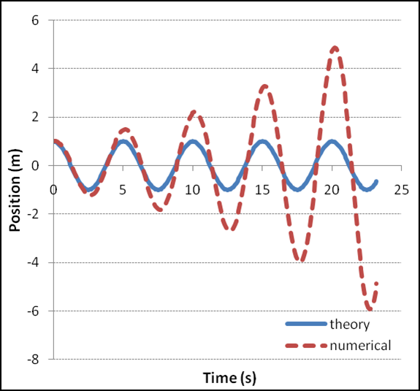
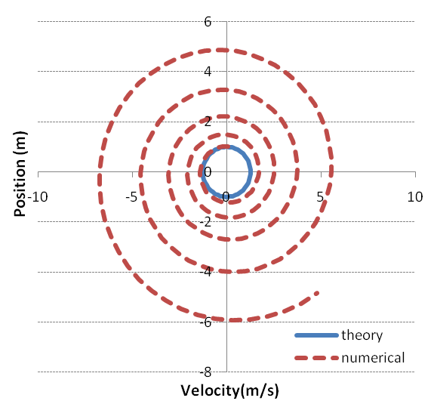
forward differening
The forward differencing method resuls in accumulative error in time.

Slide 24
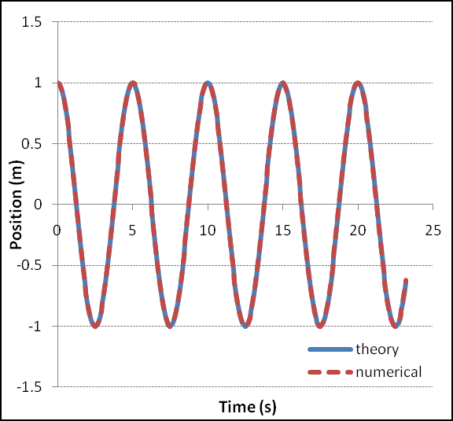
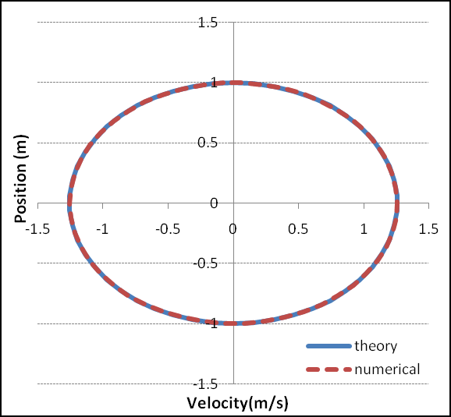
leapfrog method
The leapfrog method will give stable results.

Slide 25
leapfrog move
expressed in integer steps
kick-drift-kick
There are two primary strengths:
The time can be reversed. One can integrate forward n steps, and then reverse the direction of integration and integrate backwards n steps to arrive at the same starting position.
It conserves the (slightly modified) energy of dynamical systems. This is especially useful when computing orbital dynamics, as B-field is strong. Good for long tracking problem.
kick
drift
kick

Slide 26
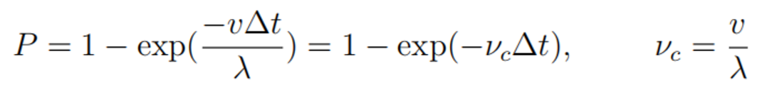
Collision
Collision: Yes or Not?
Collision: Yes or Not?
Collision: Yes or Not?
Collision
In physcis, collison occurs during the movement.
Computationally, collision is decoupled from the velocity and position integration, in which there is no collision occuring within between. Collision is applied at a fixed, constant point in the timestep.
The collision probability is given by,
P = v_{c}∆t, when v_{c}∆t <<1. λ can be a function of v, although not sensitive.
This technique limits the simulation to a maximum single collision within a timestep. For a higher collision rate, it results in a breaking down of timestep into smaller segments.

Slide 27
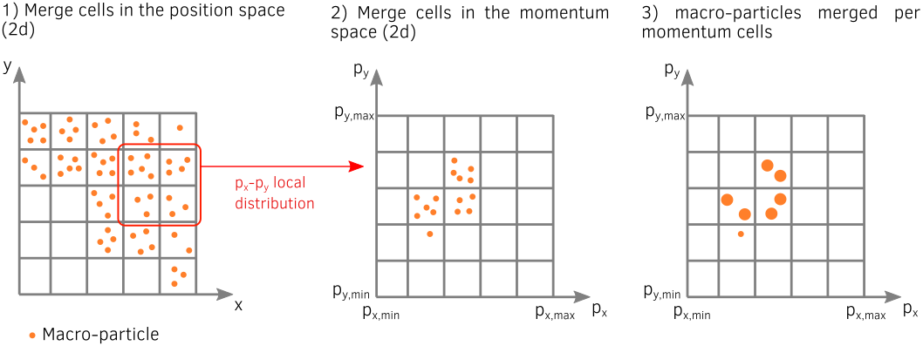
particle merging
The ability to merge pseudo-particles can speed-up the code efficiency and reduce the memory footprint in some specific simulation scenarii:
When chemical reactions occur, such as recommbination (e + Ar⁺ = Ar)
When pseudo-particles accumulate in a fraction of the simulation domain hence strongly worsening the load imbalance.
When pseudo-particles are generated in a large quantity due to some additional physical mechanisms (ionization, macro-photon emission, QED pair production…)
When pseudo-particles travel in large quantities outside interesting physical regions.
Position is the mass center of merging particles, while conserving charge, energy and momentum.
The counterpart of merging, particle splitting is a sophiscated technique, not discussed here.

Slide 28
PIC 1D example
Plamsa
~
Conditions:
Ar discharge at 20 mTorr.
AC voltage is applied to left electrode; right electrode is grounded.
Width = 10 cm.

Slide 29
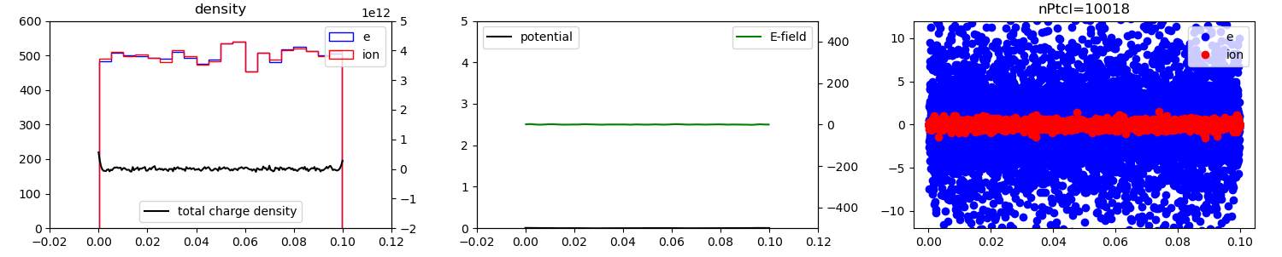
PIC 1D example
Initial conditions:
Uniform denisty within the gap. Initial 10k particles.
Initial potential and E-field are 0
Electrons have wider velocity distribution due to higher T_{e}. Ions have much narrower velocity distribution.
Lossy boundary condition for left and right. No voltage is applied.

Slide 30
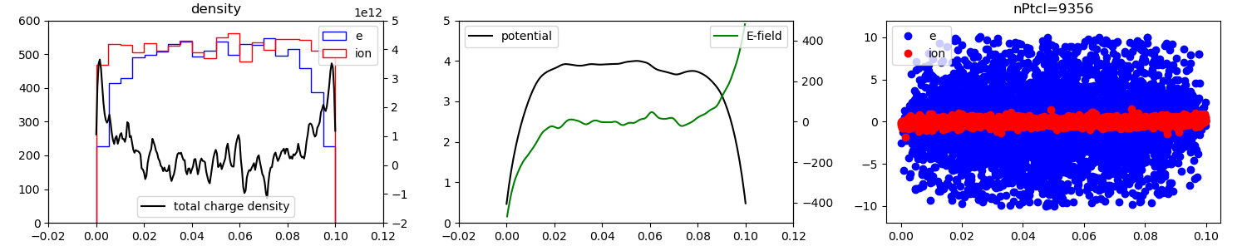
After 1 μs
Initial conditions:
Electrons move faster and get lost more to electrode, while ions stay within the gap.
Charge is built up within the gap.
Potential and E-field is built up within the gap. E-field holds electrons to the center and pushes ions to boundaries.

Slide 31
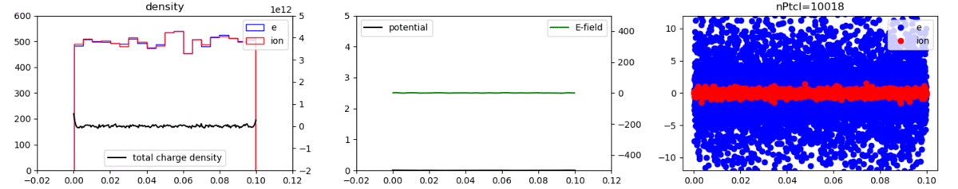
plasma evolution with time - animation
Plasma evolution:
Electrons continue to lose; Ions start to lose, as ions are accelerated by E-field.
Total charge density decreases, as well as potential and E-field, since no source is provide.
When the total particles drop to half of initial number, the E-field is too small to hold the plasma, which means no plasma anymore. Electrons and ions start to diffuse freely and independently.

Slide 32
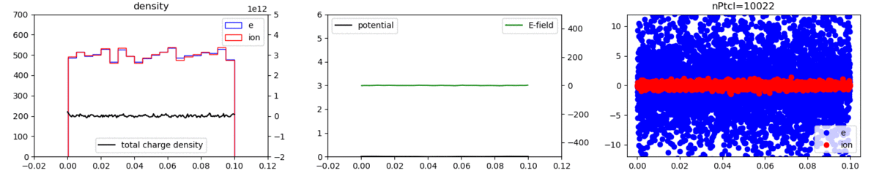
plasma evolution with time - 300 W
Plasma evolution:
With a power input of 300 W, the plasma is able to sustain itself.
In the steady state, number of electron drops to around 5k.
Plasma density is higher at the center. The net charge density is almost uniform.
Shown in the right figure, electrons rotate counter-clockwise, which means that electrons osillate within the plasma.

Slide 33
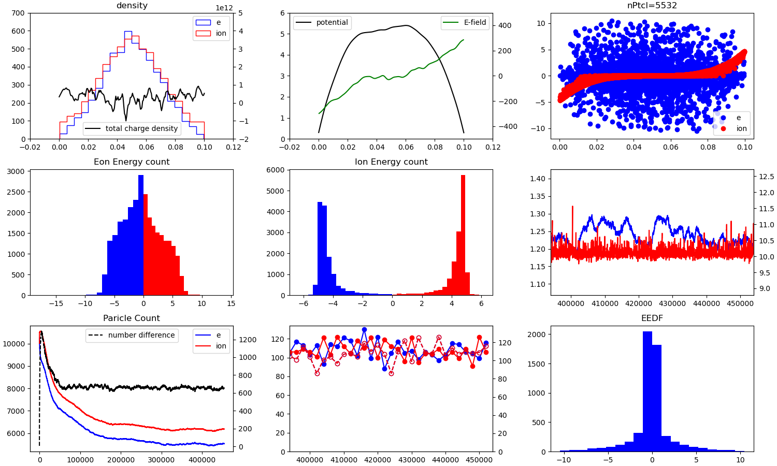
Statistics

Slide 34
Summary - Particle-in-cell
Pros. | Cons.
No difficult equations to solve. | Heavy computational laod due to a large number of particles.
Able to catch the the kinetic and stochastic phenomena. | Collisions occur frequently and fast so a extremely shrot time scale is required
Easy to parallelize and feasible for GPU.

